Slide 1
Analysis and Prediction of Forest Fires
CKME 136 Data Analytics: Capstone Course
Edward Donner 500862709

Slide 2
Agenda
Introduction
Research Questions
Approaches
Dataset
Initial Analysis and Exploratory Data Analysis
Model Selection
Conclusion and Recommendations

Slide 3
Introduction
Every year in Canada, thousands of uncontrolled forest fires destroy millions of hectares of land
Cost hundreds of millions of dollars in damages
Threat to wildlife and people
Forest fires also have a negative impact on the sustainability of our forests
There are two types of causes for forest fires: human and lightning

Slide 4


Research Questions
Primary Research question
Prediction of number of Forest Fires
Secondary Research Questions
Are the number of forest fires increasing or decreasing
What cause is contributing to most of the forest fires
What locations are experiencing (increasing or decreasing) forest fires
What years are experiencing (increasing or decreasing) forest fires

Slide 5
Approaches
Download the data from the website
Initial Analysis and Exploratory Data Analysis
Train and Test Data
Results and Recommendations
Data Cleaning
Model Selection

Slide 6
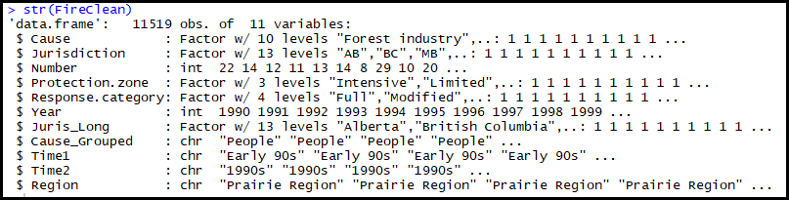
Dataset (Gathering, Cleaning & Preprocessing)
National Forestry Database

Slide 7
Dataset continued
Complete dataset:
11,519 records and 11 attributes
6 attributes chosen for relevance to topic
2 quantitative attributes and 4 qualitative attributes

Slide 8
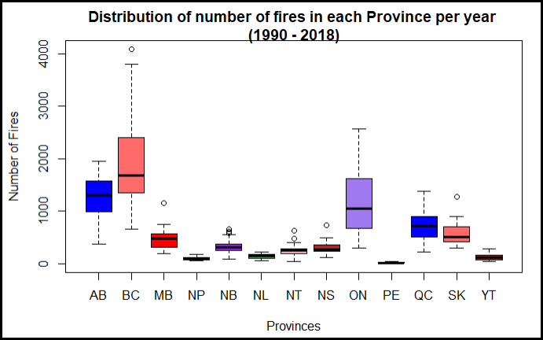
Dataset continued - Check for Outliers

Slide 9
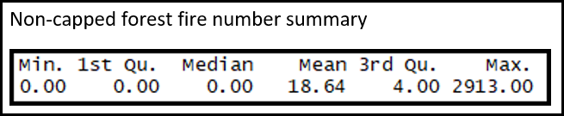
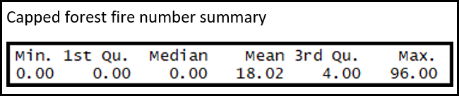
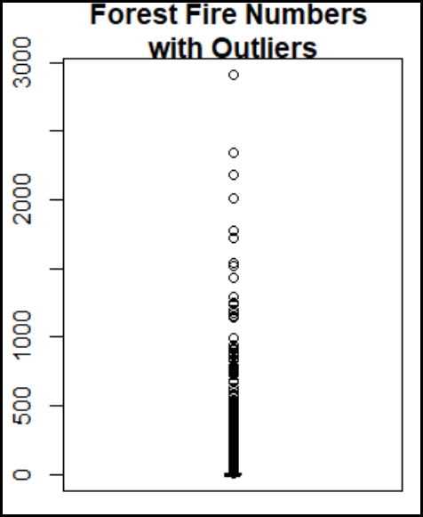
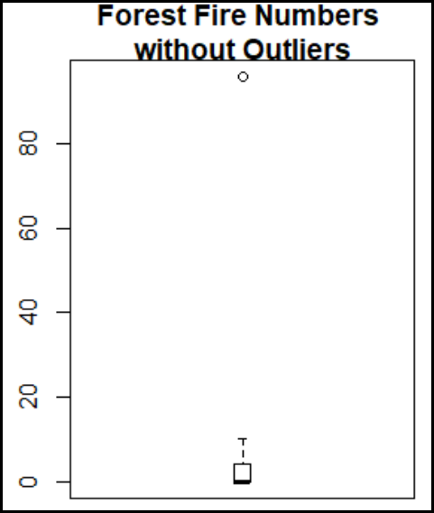
Dataset continued - Check for Outliers

Slide 10
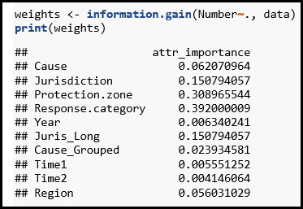
Dataset continued – Feature Selection

Slide 11

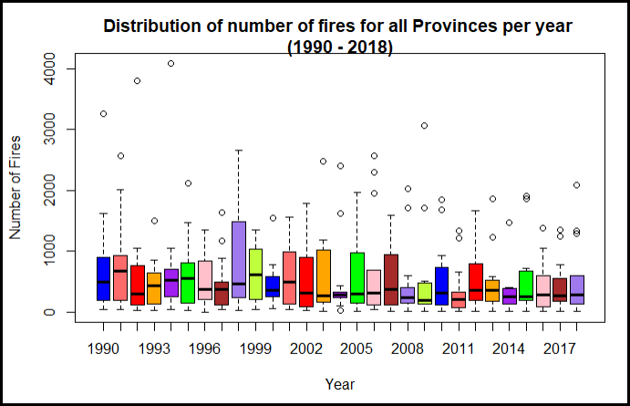


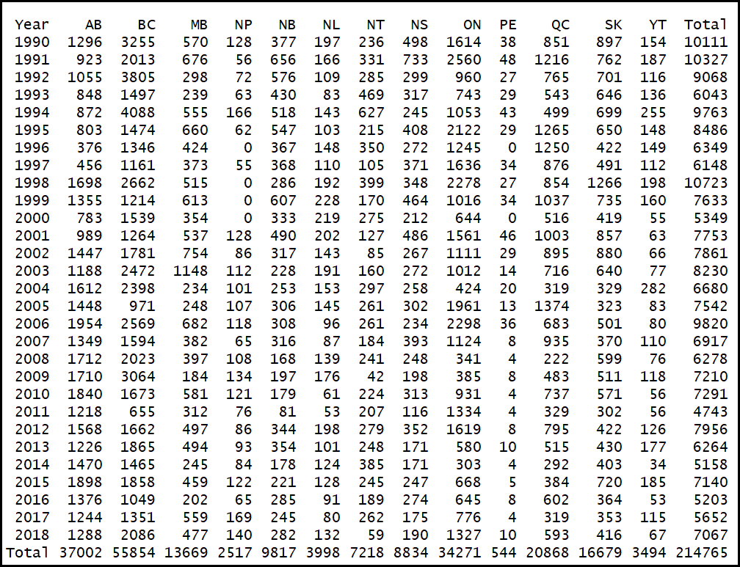

Exploratory Data Analysis

Slide 12
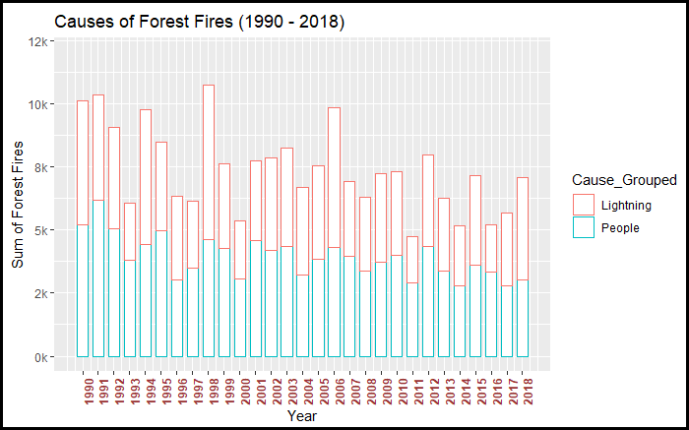
Exploratory Data Analysis

Slide 13
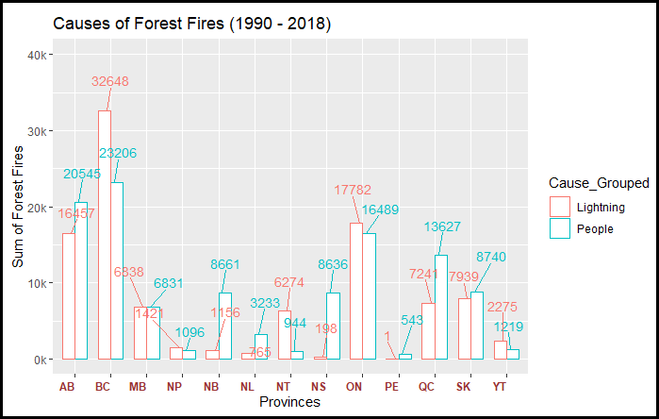
Exploratory Data Analysis

Slide 14
Exploratory Data Analysis

Slide 15
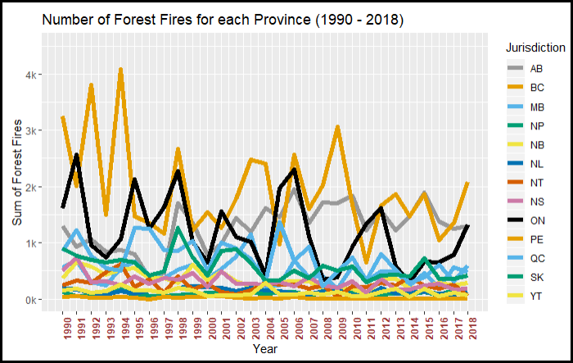
Exploratory Data Analysis

Slide 16
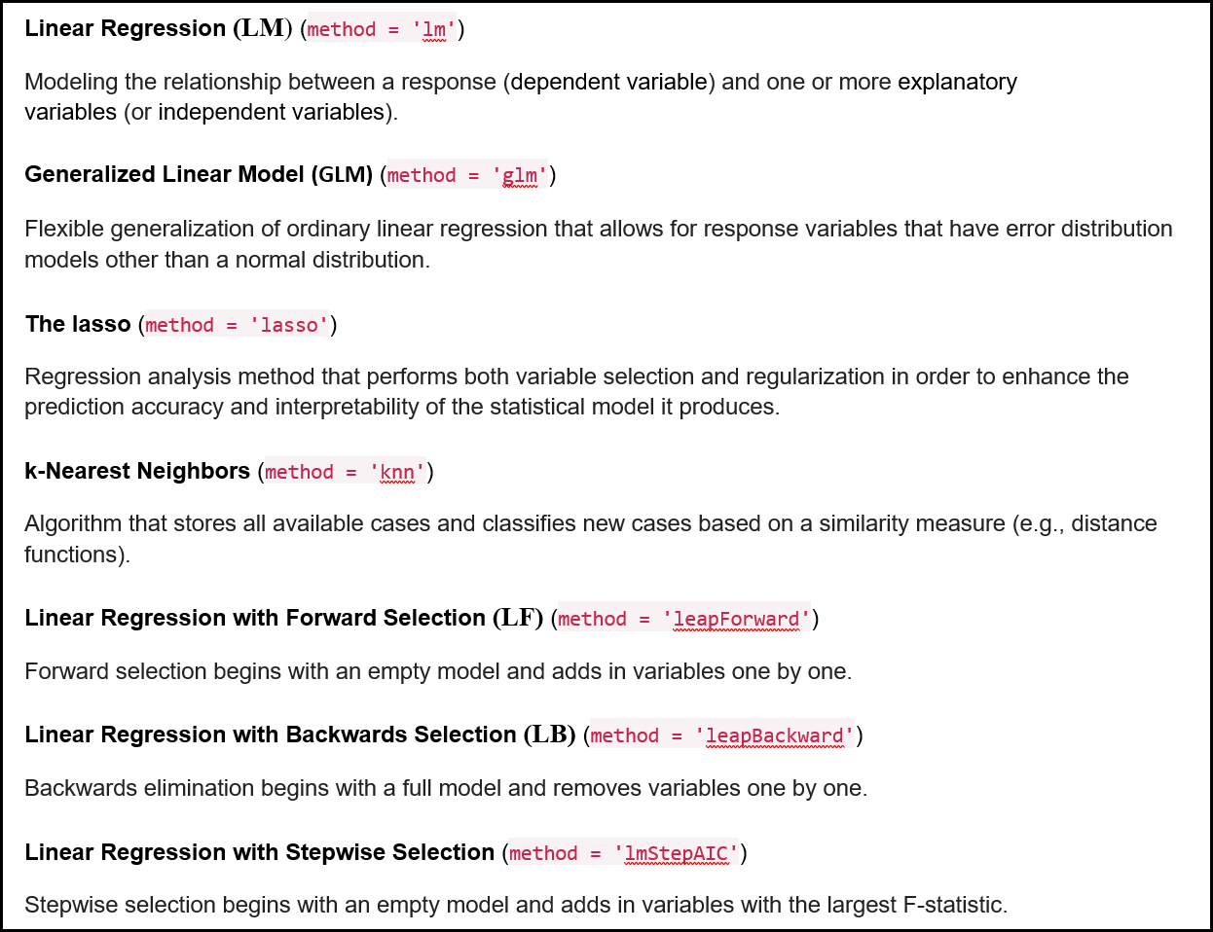
Model Selection

Slide 17
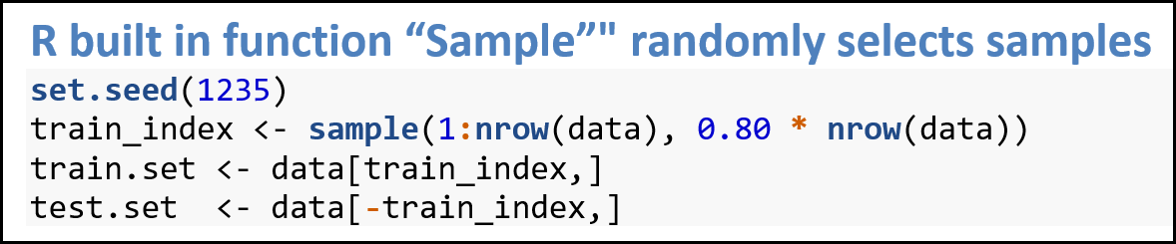
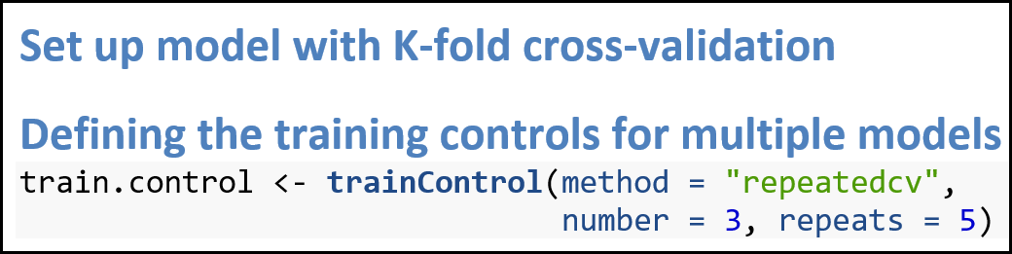
Train and Test Data
Cross-validation set up

Slide 18
Performance Measures for Models
Root Mean Square Error (RMSE)
Advantages: same units as target variable
Disadvantages: sensitive to outliers
Mean Absolute Error (MAE)
Advantages: absolute difference
Disadvantages: sensitive to outliers
R squared (coefficient of determination)
Advantages: easy to understand, between 0 and 1
Disadvantages: R-squared can be increased by adding independent variables to the model which is misleading since some added variable might be useless with minimal significance

Slide 19
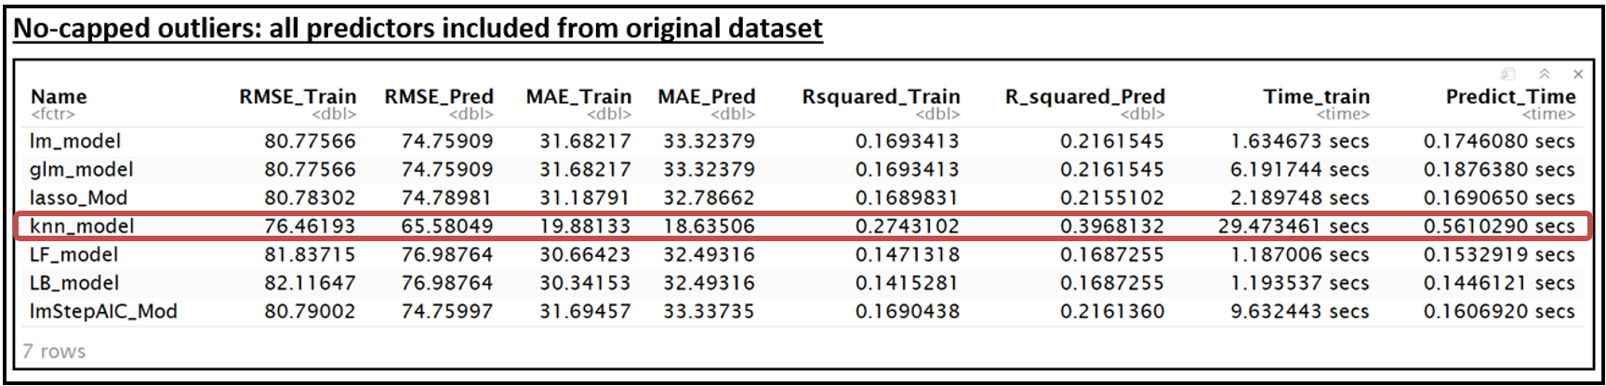
Best Performing Model: KNN

Slide 20
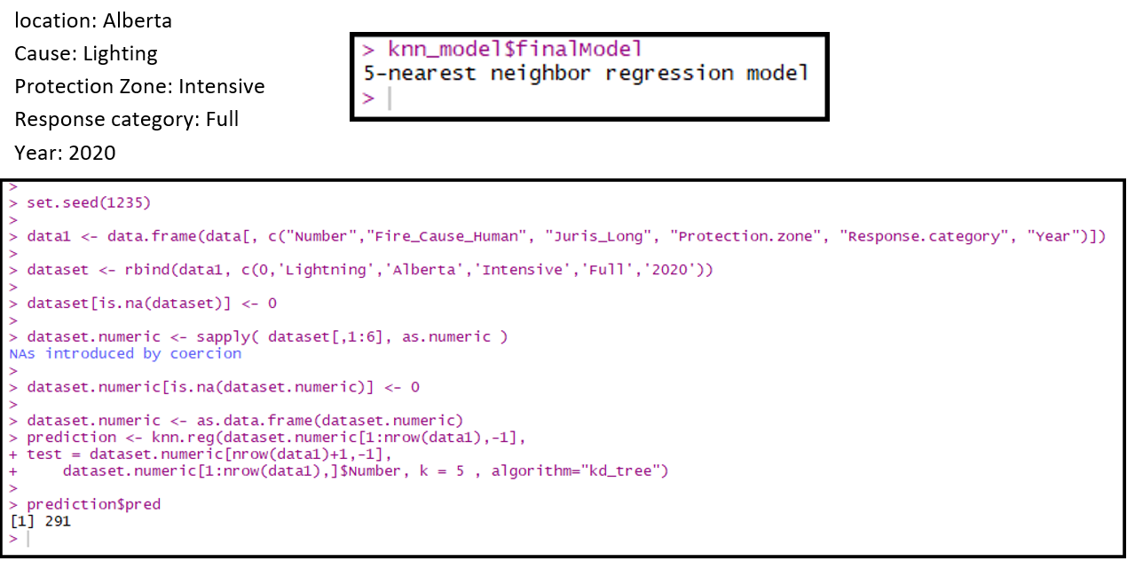
Best Performing Model: KNN

Slide 21
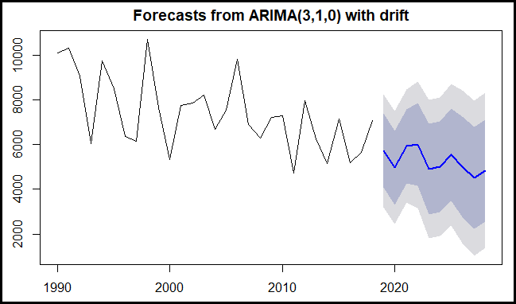
Forecasting with time series

Slide 22
Conclusion and Recommendations
KNN (K = 5) best model
Predict the number of forest fires: 291
Are forest fires increasing or decreasing: trend is decreasing
What is the cause of most forest fires: lightning
What locations have more forest fires: Western Canada
What year(s) have more forest fires: 1990, 1991, 1997

Slide 23
Limitations
7 models only
Regression analysis only
Many different performance measures available
Other predictors can be imported to improve results
Larger datasets require more powerful computers

Slide 24
Thank you!
Questions?

